Slide 1



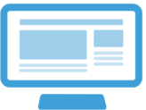










LSST Users
Internet
LSST Science Platform
Portal
Notebooks
Web APIs
Data Releases
Alert Streams
User Databases
User Files
User Computing
Software Tools

